Slide 1
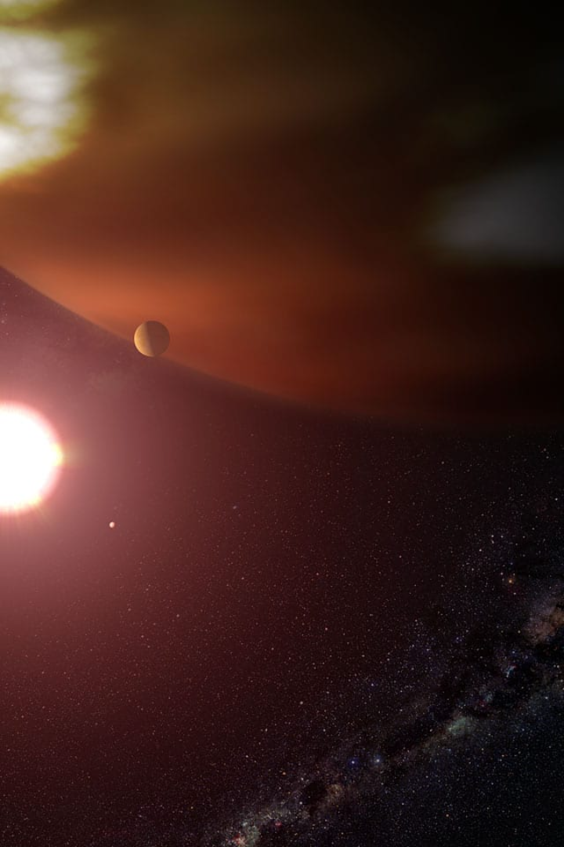
Analyzing Exoplanets using Transit Finder Data
Unlocking the Mysteries of Exoplanets Through Transit Methods
Presented by: Rahavi S

Slide 2
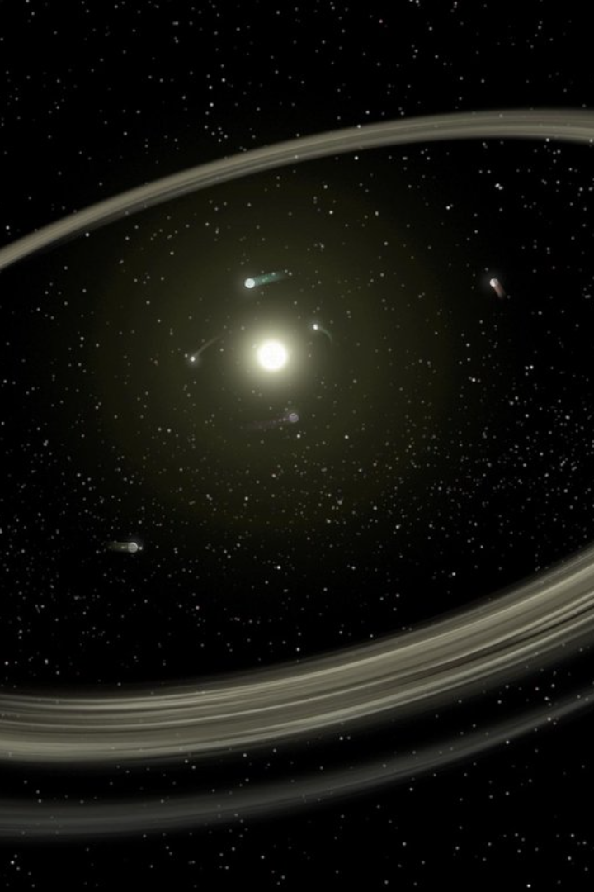
Introduction
Welcome to our presentation on analyzing exoplanets using transit finder data. Today, we'll explore the fascinating world of exoplanets and delve into the transit method for detecting and analyzing these celestial bodies. A key focus will be on the valuable data provided by Transit Finder and its relevance to exoplanet research.

Slide 3
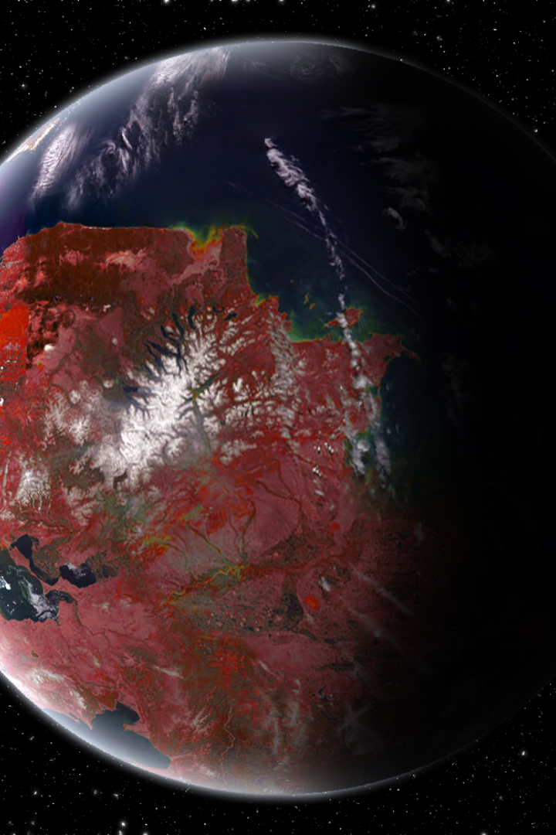
What Are Exoplanets?
Exoplanets are planets that orbit stars outside of our solar system. These distant worlds hold immense scientific importance as they offer insights into planetary formation, the potential for life beyond Earth, and the vast diversity of our universe.

Slide 4
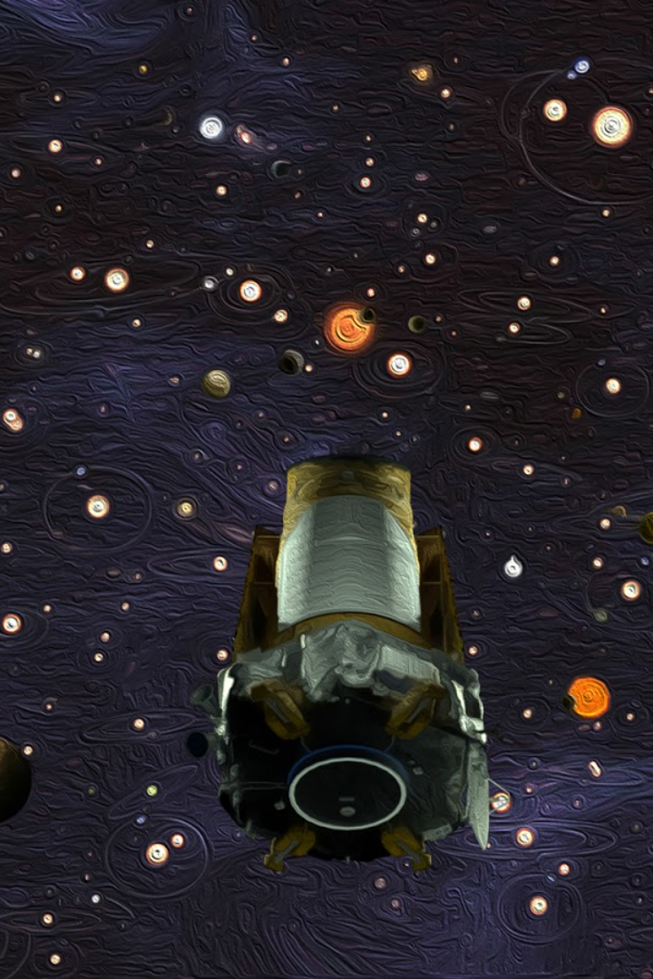
Detection Methods
Various methods are employed to detect exoplanets, including radial velocity measurements, direct imaging, and the transit method. Among these techniques, the transit method plays a crucial role in our understanding of exoplanetary systems.

Slide 5
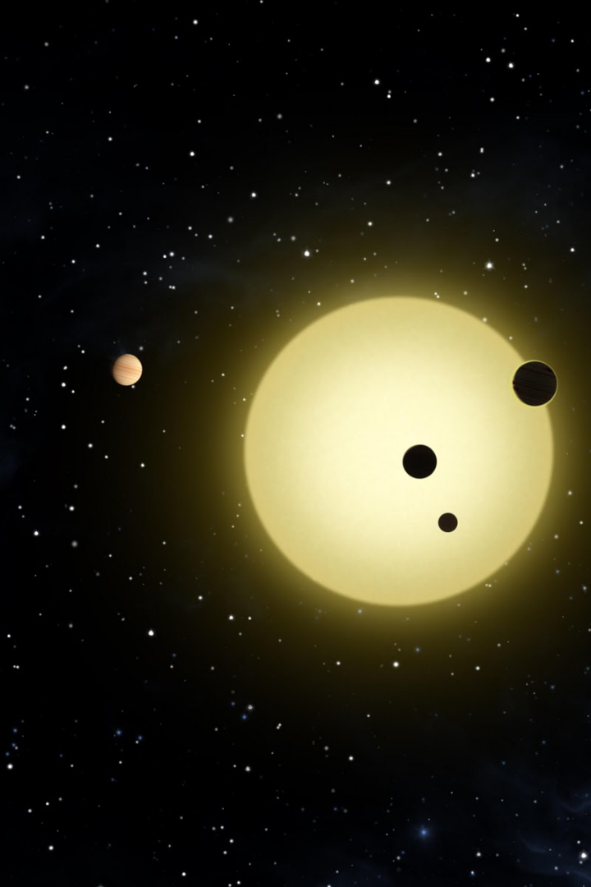
The Transit Method
The transit method involves observing and analyzing the temporary decrease in a star's brightness caused by an exoplanet passing in front of it. By carefully studying these transit events, astronomers can gather essential information about the exoplanet's characteristics.

Slide 6
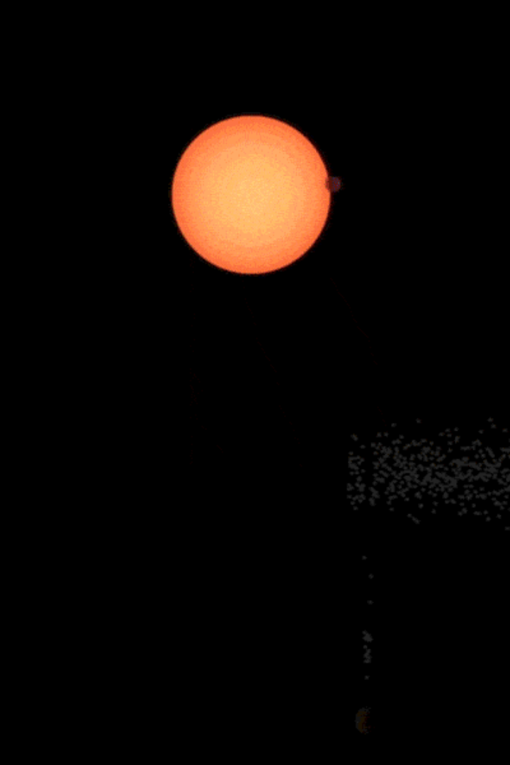
Transit Light Curves
Transit light curves are graphical representations of the brightness fluctuations observed during a transit event. These curves provide valuable data points that help scientists determine key properties of the exoplanet, such as its size, orbital period, and orbital inclination.

Slide 7
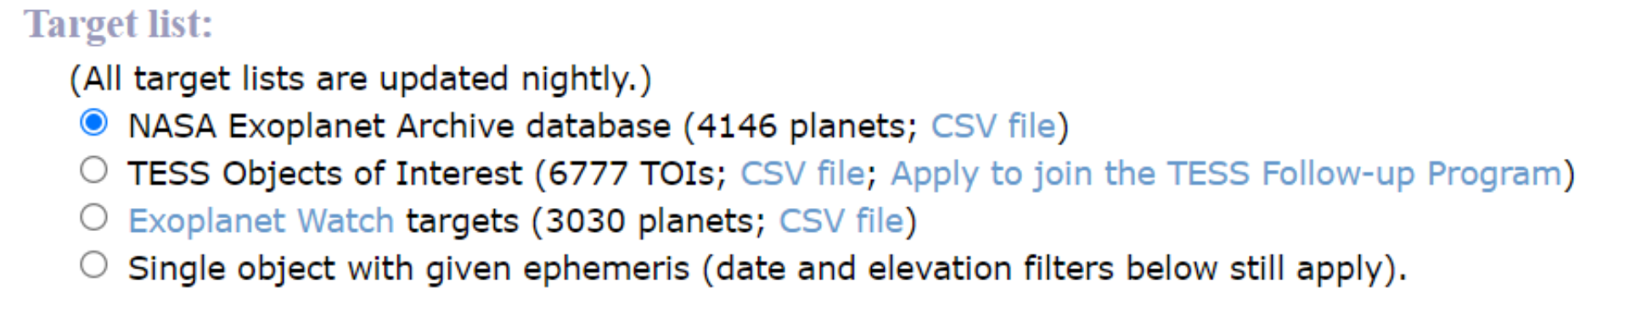
Data Source - Transit Finder
Transit Finder serves as an invaluable resource for astronomers and researchers in the field of exoplanet studies. This comprehensive tool provides access to a vast database of transit observations, allowing scientists to analyze and interpret transit light curves with ease.

Slide 8
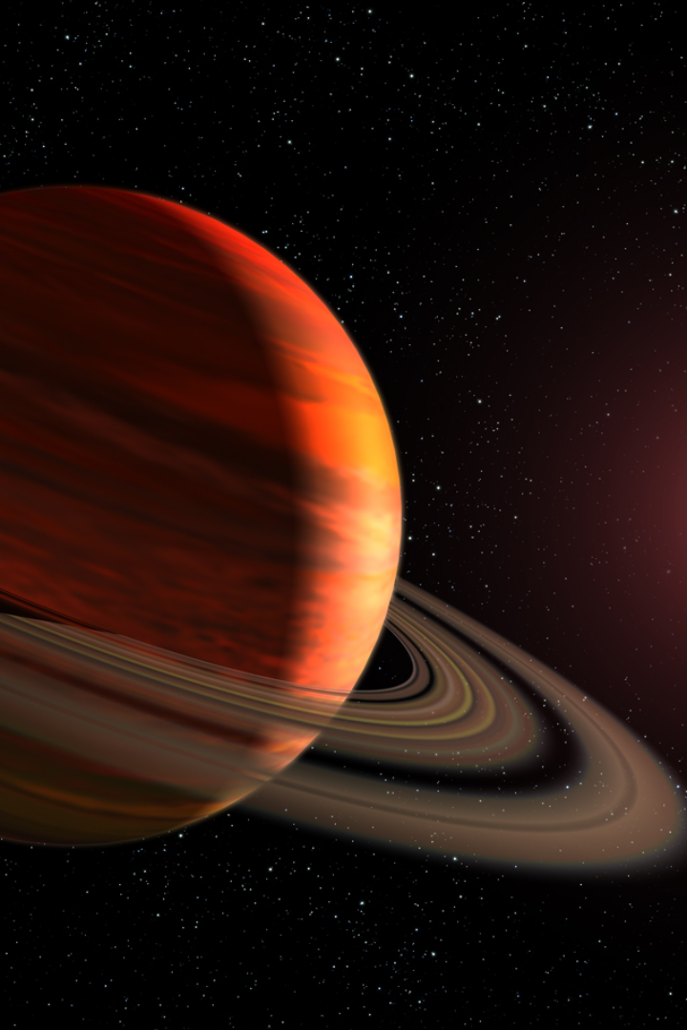
Analyzing Exoplanets
Using Transit Finder data, researchers can unlock vital information about exoplanets. This includes determining the size of exoplanets based on the depth of transit events, calculating the orbital period by analyzing the time between successive transits, and inferring orbital inclination from the shape of the transit curve.

Slide 9
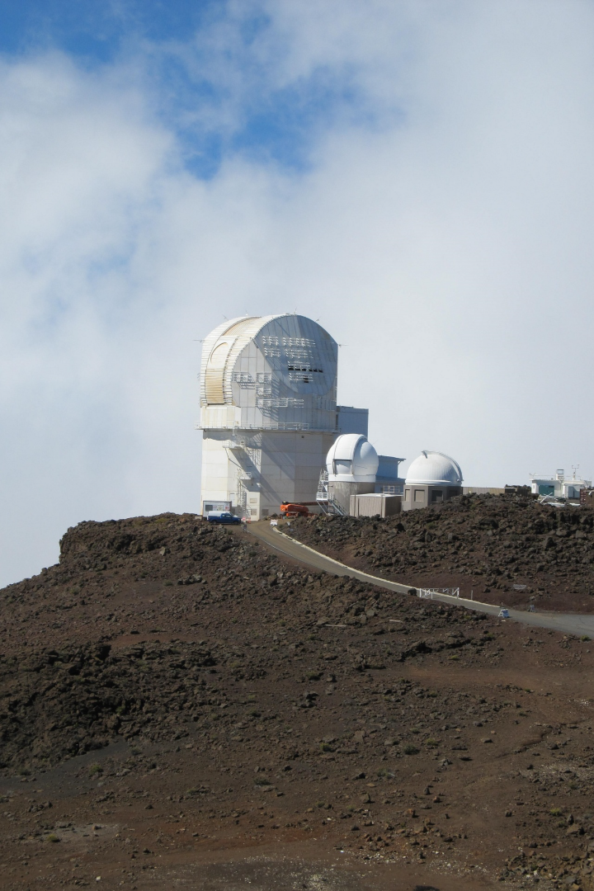
Predict Future Transits
Using the transit epoch and period, you can predict when future transits will occur. The transit epoch refers to the specific time when a transit was observed, and the transit period is the time it takes for the planet to orbit its star and transit again.

Slide 10

Confirming Exoplanets
Confirmation of exoplanets discovered through transit methods often requires additional techniques, such as radial velocity measurements. The combination of Transit Finder data with other observational tools and methods enhances the certainty and credibility of exoplanet discoveries.

Slide 11
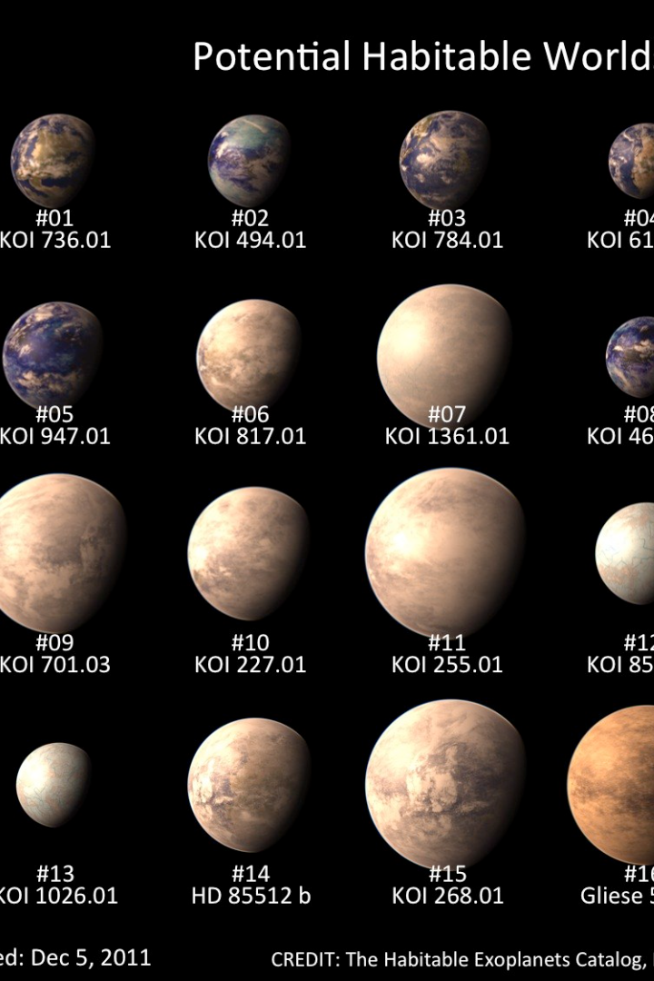
Cataloging and Characterizing Exoplanets
Transit Finder, alongside similar tools, plays a crucial role in the cataloging and characterization of exoplanets. The exponential growth in exoplanet discoveries using the transit method has revolutionized our understanding of planetary systems, from hot Jupiters to potentially habitable rocky worlds.

Slide 12
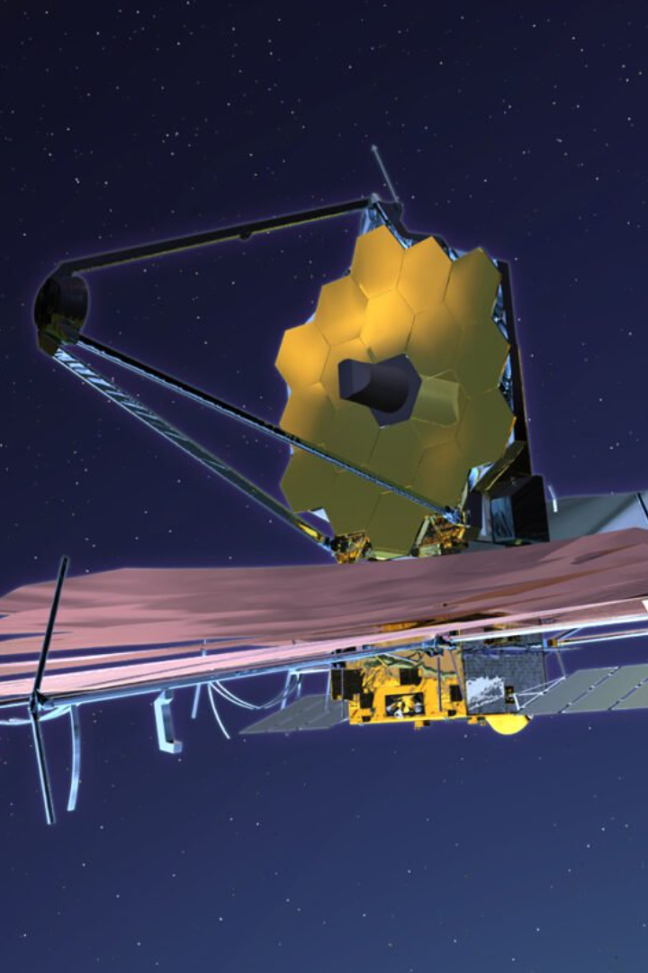
Ongoing Research and Future Prospects
The field of exoplanet research continues to evolve rapidly. Ongoing missions, advancements in observational technologies, and future missions like the James Webb Space Telescope hold tremendous promise for advancing our knowledge of exoplanets and potentially discovering habitable worlds beyond our solar system.

Slide 13
Conclusion
In conclusion, analyzing exoplanets using transit finder data allows us to unlock the mysteries of these distant worlds. With Transit Finder's comprehensive database and the powerful insights provided by the transit method, we continue to expand our understanding of exoplanetary systems, furthering humanity's quest to unravel the secrets of our universe.

